Slide 1

Prokaryotic Genomes: bacteria
Prepared by
Dr. Rawa Abdul Redha Aziz
Ph.D Antibiotics/ Molecular biology
Dr. Hiba Shakir Ahmed
Ph.D Microbiology/Immunity

Slide 2
They are generally smaller and less variant in size among species when compared with genomes of animals and single cell eukaryotes. There are three types of genome as following:
1. Circular chromosomes Prokaryotic DNA is composed of double-stranded anti-parallel DNA strand. Most prokaryotes have circular chromosomes. The genome is supercoiled with one negative turn ever 200 bp-twists, which aids in compaction of the DNA inside the cell.

Slide 3
2. Linear chromosomes Some prokaryotes have linear chromosomes. Inverted repeats at the end of the linear chromosome function like telomeres to ensure fidelity of DNA replication to the end of the chromosome. An example of a species with a linear chromosome is Streptomyces.
3. Nucleoid architecture Bacterial chromosomes have (at least) four histone-like proteins that are involved in maintaining the architecture and compactions of the chromosome. HU, IHF, FIS and H-NS. The bacterial chromosome and associated proteins is called the nucleoid.

Slide 4
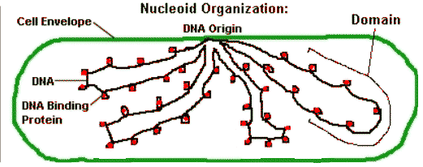

Slide 5
B. Genome structure and regulatory aspects
1. Operon: is a group of genes that has a single promoter site (site where RNA polymerase binds and transcribes mRNA) and is transcribed as a single polycistronic mRNA molecule.

Slide 6
2. Regulon: is a set of operons that may be scattered across the chromosome but that are all controlled by the same regulatory protein. These operons encode proteins associated with a cellular function or pathway.
3. Modulon/Stimulon: is a regulatory protein that regulates operons as a global response to stress, nutritional parameters and heat shock. It is thought that approximately 50 global regulatory systems exist in a typical prokaryotic cell.

Slide 7
Plasmids
    Sizes of plasmids can range from a few kilobase pairs to hundreds of kbp and can be linear or circular. Broad host range plasmids can replicate in diverse bacteria (encode own replication machinery). Narrow host range plasmids can replicate only in related bacteria or single species (require host factors for replication).

Slide 8
Traits commonly found on plasmids are:
a. Antibiotic resistance
b. Colicins and bacteriocins: antimicrobial compounds.
c. Virulence determinants-toxins.
d. Virulence determinants for plant pathogens.
e. Metabolic activities, utilization of carbon sources, sucrose, lactose, urea, etc. degradation of toxic compounds, toluene, aromatic compounds.
f. Nitrogen fixation.
g. Some plasmids do not confer any obvious phenotype to their host.

Slide 9
Genetic analysis
A. Conjugal transfer
It is the unidirectional transfer of either plasmid or chromosomal DNA from one cell to another by cell-cell contact. DNA transfer is not reciprocal, therefore the two cells that participate are referred to as "donor" and "recipient".

Slide 10
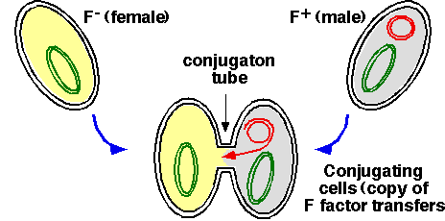

Slide 11
B. Transduction
Fragments of bacterial chromosome are incorporated into phage heads and are transduced into new host cells. Not all bacteriophages are capable of transduction. The host cell DNA must be degraded to an appropriate size to be packed in the phage head and the specificity of the packaging process must be low. The transduced DNA, if it is a plasmid, can replicate autonomously in the host, but if it is host DNA, it must recombine with the new host chromosome to be maintained.

Slide 12
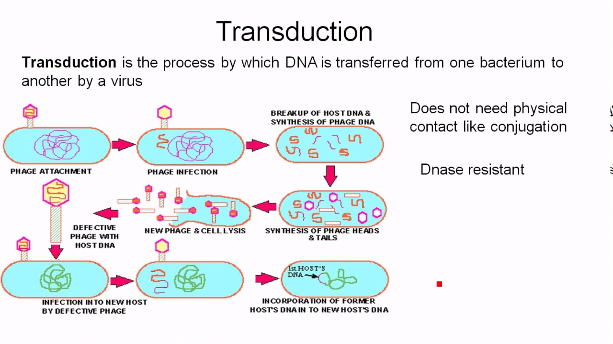

Slide 13
C. Transformation
It is actively uptake DNA fragments or free plasmids released from damaged cell by another cell like in the chart below:

Slide 14
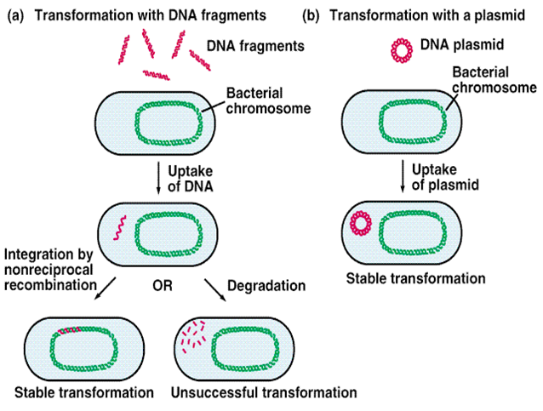

Slide 15
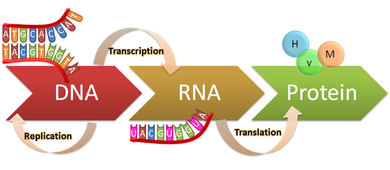
Central Dogma

Slide 16
1. DNA Replication:
-It is the biological process of producing two identical replicas of DNA from one original DNA molecule. This process occurs in all living organisms and is the basis for biological inheritance. The cell possesses the distinctive property of division, which makes replication of DNA essential.

Slide 17
- Process needs:
1) DNA polymerase
2) Helicases
3) Ligase
4) The 4 dNTP
5) DNA primase
6) Primer
7) Topoisomerase
8) Single strand binding protein (SSB)

Slide 18
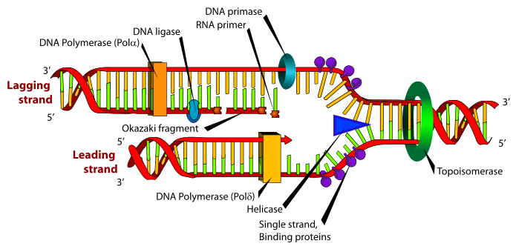

Slide 19

Any Question?

